Slide 1
Project Overview
Stock Price Prediction using Regression
Goal: Predict stock closing prices using historical data
Dataset: Market price data
Target Variable: Close price
Input Features: Open, High, Low, Adj Close, Volume
Preprocessing & Models
Data Preparation and Algorithms
Feature scaling applied for Linear & Polynomial Regression
No scaling required for Decision Tree & Random Forest
Models used:
  Linear Regression
  Polynomial Regression
  Decision Tree
  Random Forest

Slide 2
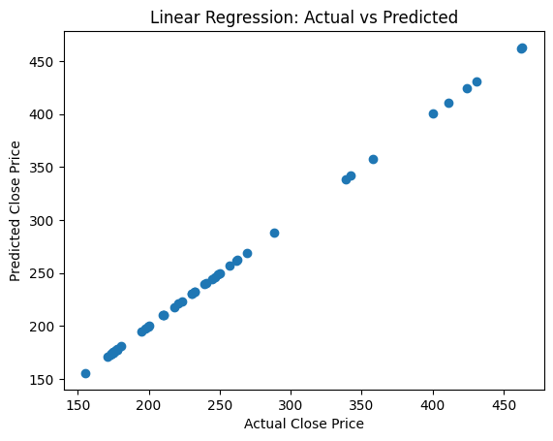
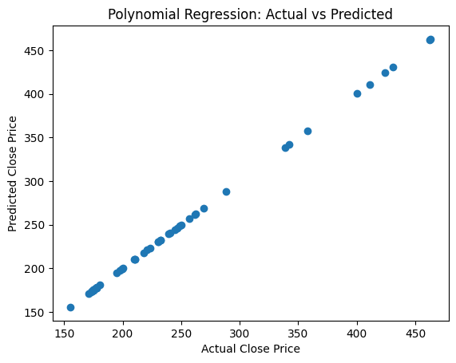
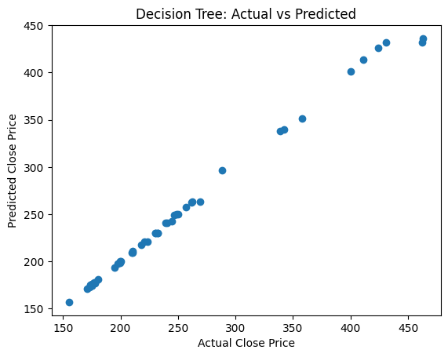
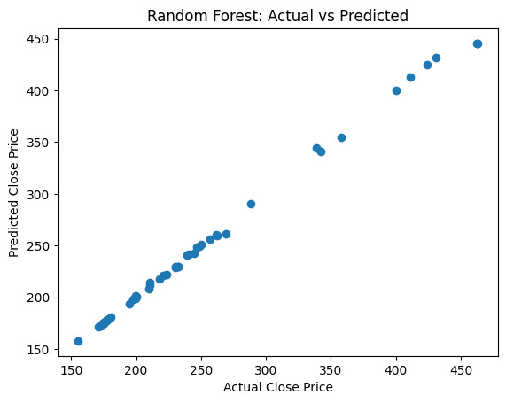

Slide 3
Performance Measurement
Metrics used:
  R² Score
  RMSE
R² evaluates explained variance
RMSE measures prediction error
“Why are results so good?”
Reason: Strong correlation among price features
Stock price features such as Open, High, Low, and Adjusted Close are highly correlated with the closing price, the models achieved very high accuracy, leading to similar prediction patterns across models.

